Slide 1

TICTACTOE GAME USING JACK LANGUAGE
ELEMENTS OF COMPUTING – 2
SUBMITTED BY:
SANGGIT SAARAN K C S (CB.SC.U4AIE23247)
SURYA HA (CB.SC.U4AIE23267)
VISHAL SESHADRI B (CB.SC.U4AIE23260)
VENKATRAM KS (CB.SC.U4AIE23236)

Slide 2
ABSTRACT
This paper focuses on the implementation of the Tic Tac Toe game using the jack language and Nand2Tetris framework. By utilising Nand2tetris framework, this project showcases the creation of a fully functional software application.
Through extensive testing and evaluation, our Tic-Tac-Toe implementation demonstrated robust performance, accurate game logic, and an intuitive user experience. The results showcase how foundational knowledge can be applied to create engaging, interactive software, aiming to inspire further research and collaboration in computer architecture education.

Slide 3


INTRODUCTION
The enduring game of Tic-Tac-Toe, also known as Noughts and Crosses, has captivated players of all ages for generations. Despite its simple rules and gameplay, this classic game provides a rich avenue for exploring various aspects of computer science, such as algorithm design, data structures, and user interfaces.
The goal of this project is to create a fully functional, interactive Tic-Tac-Toe game using the Jack language, a sophisticated, object-oriented programming language specifically designed for the Nand2Tetris software.
The Nand2Tetris software suite stands out as a comprehensive educational platform presenting a distinctive approach to comprehending computer systems from their foundational roots. The Jack language plays a pivotal role within this suite, offering a contemporary, object-oriented programming language that facilitates the development of interactive applications.

Slide 4
Related work review
we explore educational approaches integrating computer architecture and software development. We focus on the Nand2Tetris project, project-based learning (PBL) in computer architecture, and educational software development using high-level programming languages.
Nand2Tetris, led by Noam Nisan and Shimon Schocken, guides students through building a computer from NAND gates to a high-level language.
Project-based learning (PBL) in computer architecture enhances problem-solving skills and system-level design understanding compared to traditional lecture-based courses.
Comparing our Tic-Tac-Toe project with Jayson Joseph's TicTacToe.jack, we emphasize player vs. player interactions and additional features like customizable board sizes and undo functionality. Despite differences, both projects use Jack within the Nand2Tetris framework for educational purposes.

Slide 5
DESIGN AND IMPLEMENTATION
There are mainly 5 jack files in our project
Board.jack
TicTacToeGame.jack
InuputUtil.jack
Piece.jack
Main.jack
Board.jack :
The Board class forms the core structure of our Tic-Tac-Toe implementation, encompassing various functionalities crucial for managing the game. It operates the game state, player moves, and graphical representation on the screen.

Slide 6
The class encapsulates essential variables such as the boardArray, which tracks the state of the game board, and parameters defining the board's dimensions and appearance. Boolean flags like isWin and isDraw indicate whether the game has been won or drawn, while other variables store information about winning modes and the number of vacant cells.
Upon instantiation, the constructor initializes the board based on specified coordinates and dimensions. It calculates the size of the board and individual cells, clears the board's state, and draws the necessary borders for visual representation.
Methods like clearBoard and dispose ensure the reset and cleanup of the board's state and graphical elements. Drawing methods handle the rendering of the board and any winning lines.
For game state evaluation, methods like isWin and isDraw determine if a win or draw condition has been met. The evaluateBoard method assesses the current state of the board, updating relevant variables accordingly.
Player moves are managed through methods like drawMove and makeMove, which visually place a move on the board and update the game state, respectively. The class also supports undo functionality via the takeBackMove method, which restores the previous state and reevaluates the board.

Slide 7
TicTacToeGame.jack
The TicTacToeGame class serves as the central controller for our Tic-Tac-Toe game, overseeing game initialization, player input, game logic, and overall flow. It interacts closely with instances of the Board class for managing the game board and the Piece class for representing player pieces.
The init() method sets up the game environment, initializing necessary components and player pieces.
The processBoard() method evaluates the current state of the game board, calling the evaluateBoard() method from the Board instance. If there's a win, it draws the winning line and returns an integer indicating the game state.
The play() method manages player moves, prompting for input, validating it, and updating the board accordingly. It also supports undo functionality and returns an integer representing the game state.
The startGame() method orchestrates the main game loop, handling game setup, player turns, and game over conditions. It provides options for restarting the game if desired.
Additional utility methods facilitate various operations such as switching between players, converting input to board coordinates, setting the seed value, generating a random seed, and displaying game credits.

Slide 8
InputUtil.jack
The InputUtil class manages user input and screen messages efficiently. It contains various methods tailored for different input scenarios, ensuring seamless interaction with the game.
variables ir and ic represent the row and column coordinates for message display, initialized to 1 by the init() method. The eraseMessage() method clears the previous message by positioning the cursor at the specified coordinates and printing a space character. The showMessage(String s) method builds upon eraseMessage() to display a new message at the designated coordinates.
For obtaining integer inputs from users, the readInt(String prompt) method prompts the user and waits for a valid single-digit input. To respond to different board sizes, methods like readInput3(String s), readInput4(String s), and readInput5(String s) are provided. These methods ensure inputs within the valid range for each board size and support options to quit or undo the last move.
The waitForZeroOrOne(String s) method facilitates choosing the player's piece (0 for naught, 1 for cross) and returns the corresponding integer. Through interaction with the screen and keyboard using Jack language's Output and Keyboard classes, the InputUtil class simplifies input handling while ensuring valid moves and managing message display efficiently.

Slide 9
Piece.jack
The Piece class serves a fundamental role in representing and visually rendering the game pieces (naughts and crosses) within our Tic-Tac-Toe game. Key fields within this class include type, indicating whether the piece is a naught (1) or a cross (2), and width and height, both defaulted to 16 to define the dimensions of the piece.
The constructor Piece(int t) initializes the piece type based on the provided parameter t, facilitating the creation of naughts and crosses. Methods like getType() allow the game logic to differentiate between naughts and crosses, essential for determining game outcomes.
The drawPiece(int x, int y) method is responsible for rendering the piece on the screen at specified coordinates (x, y). Depending on the piece type, it invokes either drawNaught or drawCross methods.
drawNaught(int x, int y) calculates outer and inner radii based on the piece's dimensions to draw a circular naught using Screen.drawCircle, creating a ring effect.
On the other hand, drawCross(int x, int y) constructs a cross by drawing intersecting lines within the piece's dimensions using Screen.drawLine.
Additional methods like getHeight() and getWidth() provide the height and width of the piece, aiding in precise positioning and rendering.

Slide 10
Main.jack
The Main class acts as the entry point for the Tic-Tac-Toe game, facilitating its initialization and execution. It contains a single method, main(), that sets up and starts the game. The main() method follows a simple sequence:
Calls Screen.clearScreen() to ensure a clean visual slate by removing any previous output.
Invokes TicTacToeGame.init() to set up all necessary game components and configurations.
Calls TicTacToeGame.startGame() to begin the main game loop, allowing players to start playing Tic-Tac-Toe.

Slide 11

TESTING AND EVALUATION
Our implementation of Tic-Tac-Toe utilizes the Jack language, designed for the Nand2Tetris project.
The game begins with the Main class, which calls the init method of the TicTacToeGame class to set up game components, followed by the startGame method to display game credits and prompt players to choose the board dimension.
Players take turns making moves by entering their chosen cell number, processed by the play method. This method updates the board and checks for game status, such as continuation, win, draw, or quit. Players can undo their last move using u or U, reverting the move and updating the game state.
When a player aligns their pieces to form a winning line, the evaluateBoard method identifies the win, and the drawWin method highlights the winning line. If all cells are filled without a win, the game is declared a draw, and the game loop ends. After a game ends, players can choose to restart or quit. If they restart, the game resets and reinitializes the board for a new game.

Slide 12
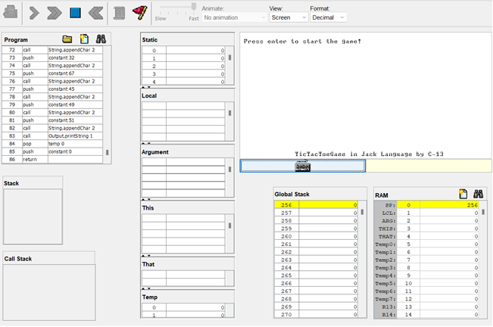
results
The game performs as expected, delivering an interactive and enjoyable experience for two players.
During testing, key features such as move placement, turn alternation, win detection, and handling of draw situations were all verified to be working correctly.

Slide 13
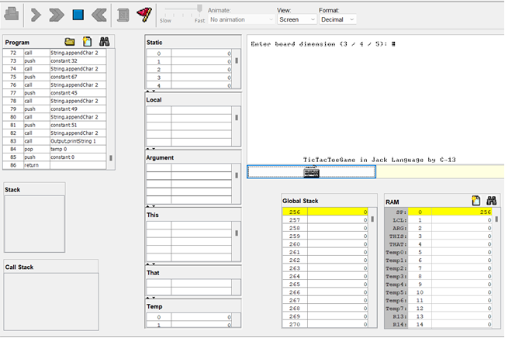

Choose the board Dimension 3 - 3x3, 4 - 4x4, 5 - 5x5
Choose the players and pieces (0 for player 1(naught piece), and 1 for player 2(cross piece))

Slide 14
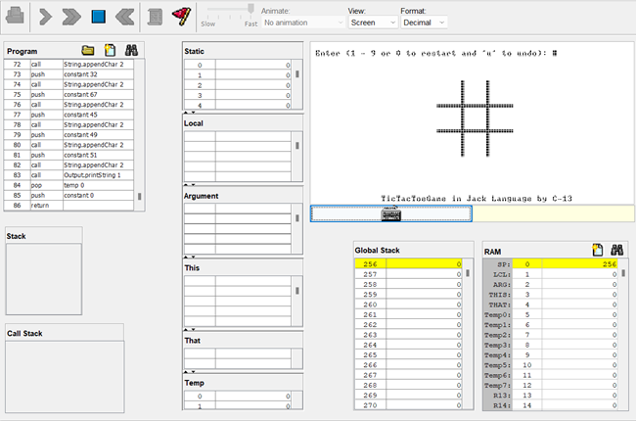
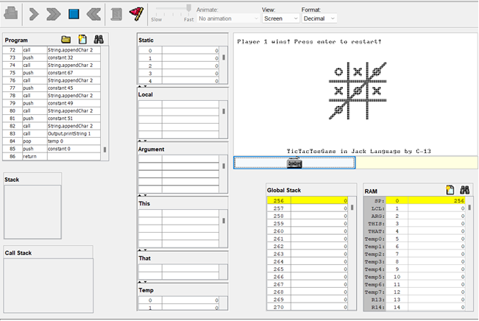
3x3 board takes input from 1 to 9 and 0 to restart and ‘u’ for undo
The Game can be played again and again but, Players need to close the application and reopen it to change the board dimension and play the game.

Slide 15
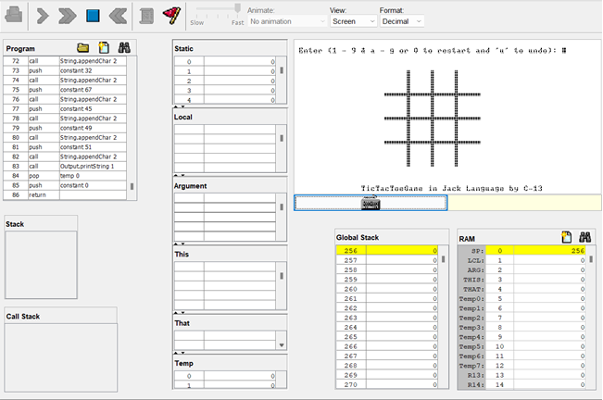
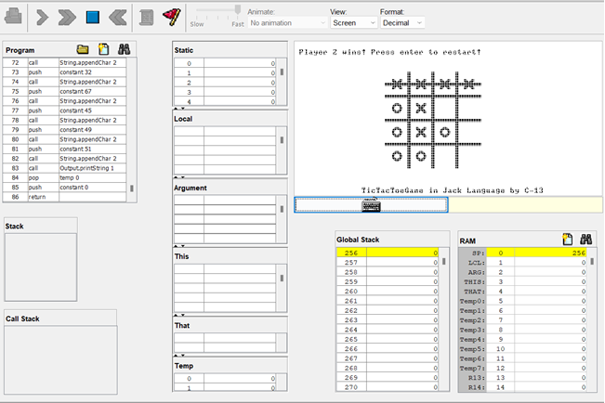
4x4 board takes 16 inputs, the input are 1 to 9 and ‘a’ to ‘g’ and 0 to restart and ‘u’ for undo
The graphical interface, managed by the Piece and Board classes, accurately renders the game board and pieces, providing clear visual feedback for each move.

Slide 16
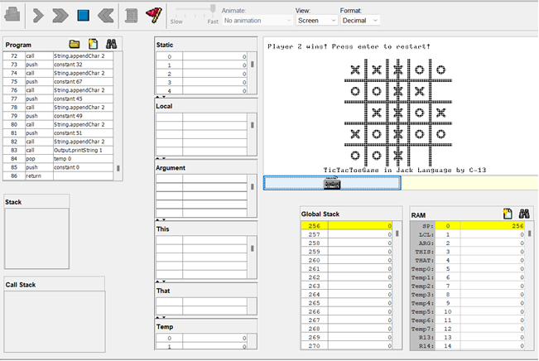

5x5 board takes 25 inputs, the input are 1 to 9 and ‘a’ to ‘p’ and 0 to restart and ‘u’ for undo
The undo move feature enhances usability by allowing players to correct mistakes without restarting.
The InputUtil class efficiently handles user inputs, ensuring smooth gameplay across different board sizes, including 3x3, 4x4, and 5x5 grids.

Slide 17
CONCLUSION
The project achieved its objectives by providing a functional, interactive game that incorporates essential features such as turn-based play, win and draw detection, and an undo feature. This project not only enhanced understanding of programming concepts but also highlighted the intricacies of game development and user interface design.
Despite some limitations, such as the lack of an AI opponent and the potential for further enhancement of the undo feature, the project lays a solid foundation for future improvements. Overall, this project provided valuable insights and practical experience in software development, making it a worthwhile educational tool.
Future improvements could involve adding an AI opponent for single-player mode, enhancing the user interface for a more modern appearance, and expanding the game to support larger grids or additional variations.

Slide 18
REFERENCE
1. Nisan, N., & Schocken, S. (2008). The Elements of Computing Systems: Building a Modern Computer from First Principles.
2. Smith, J., & Goodwin, M. (2010). Enhancing Learning in Computer Architecture through Project Based Learning.
3. Garcia, A., Romero, P., & Gonzalez, M. (2013). The Impact of Game Development Projects on Students' Learning Outcomes in Computer Science.
4. Joseph, Jayson. (2017) Tic Tac Toe game implementation in Jack language for the Hack platform (Nand2Tetris)

